Slide 1
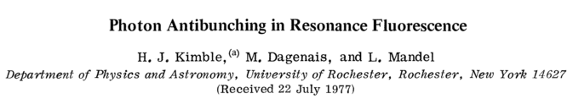
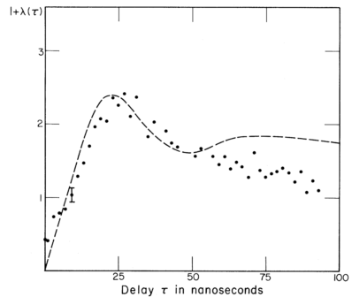
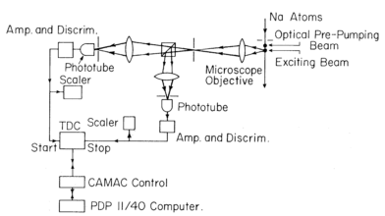
13.1 Single-Photon Sources and Detectors
SPS based on single atoms

Slide 2
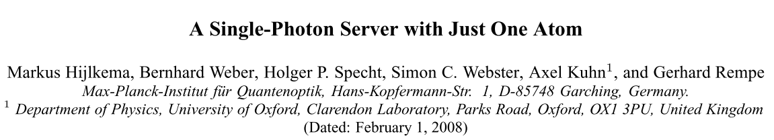
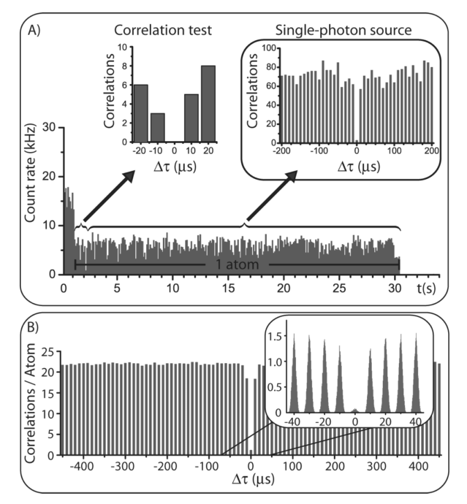
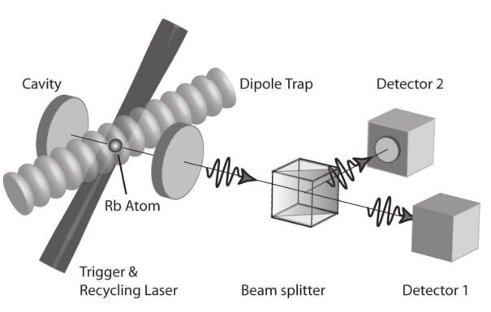
13.1 Single-Photon Sources and Detectors
SPS based on single atoms

Slide 3
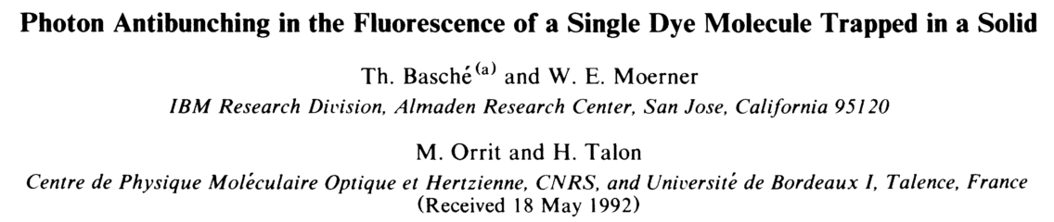
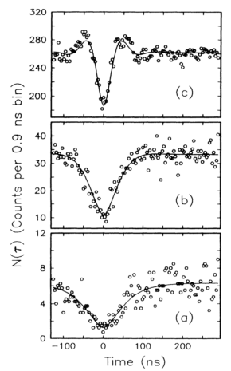
13.1 Single-Photon Sources and Detectors
SPS based on single molecules

Slide 4
13.1 Single-Photon Sources and Detectors
SPS based on single molecules

Slide 5
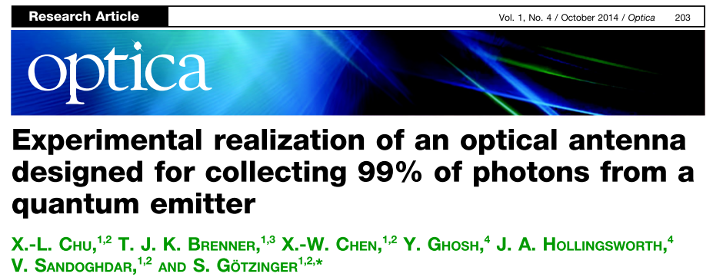
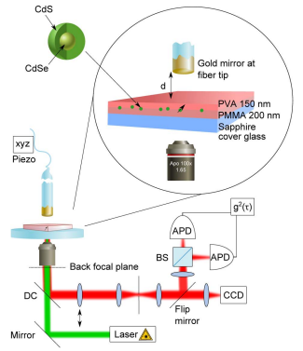
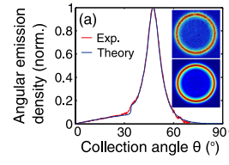
13.1 Single-Photon Sources and Detectors
Improving collection efficiency

Slide 6
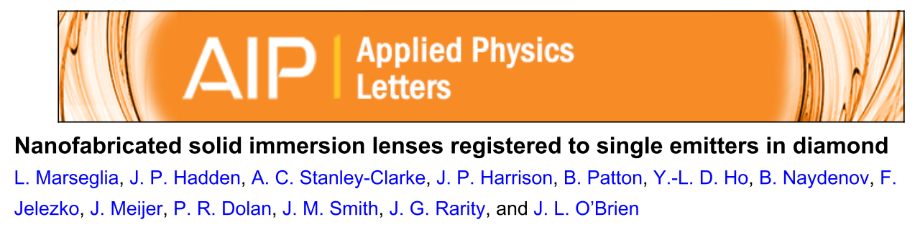
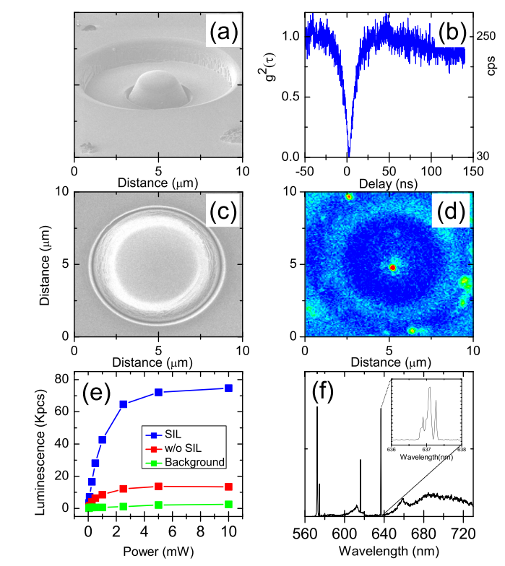
13.1 Single-Photon Sources and Detectors
SPS based on NV-Centers in Diamond

Slide 7
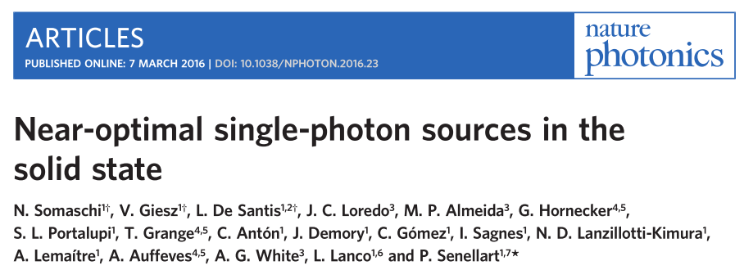
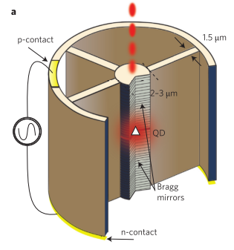
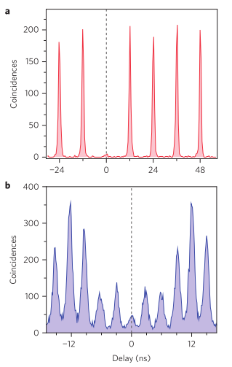
13.1 Single-Photon Sources and Detectors
SPS based on quantum dots

